Slide 1

Template Method
Behavioral Pattern

Slide 2
Intent
Define the skeleton of an algorithm in an operation, deferring some steps to subclasses.
Template Method lets subclasses redefine certain steps of an algorithm without changing the algorithm's structure.

Slide 3
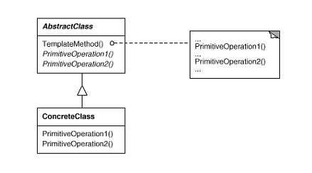
Structure

Slide 4
Description
The Template Method pattern suggests keeping the outline of the algorithm in a separate method referred to as a template method inside a class, which may be referred to as a template class, leaving out the specific implementations of the variant portions of the algorithm to different subclasses of this class.

Slide 5
Description
The Template class does not necessarily have to leave the implementation to subclasses in its entirety.
Instead, as part of providing the outline of the algorithm, the Template class can also provide some amount of implementation that can be considered as invariant across different implementations.
It can even provide default implementation for the variant parts, if appropriate.
Only specific details will be implemented inside different subclasses.
This type of implementation eliminates the need for duplicate code, which means a minimum amount of code to be written.

Slide 6
Template Class defined in 2 ways
Abstract Class
The set of variant steps can be designed as
abstract methods. Specific implementations can
be provided for these abstract methods inside a
set of concrete subclasses of the abstract
Template class.

Slide 7
Template Class defined in 2 ways
Concrete Class
The set of variant steps can be designed as
non-abstract methods with the default
implementation. Subclasses of the Template
class can override these methods to provide
specific implementations without altering the
outline of the algorithm.

Slide 8
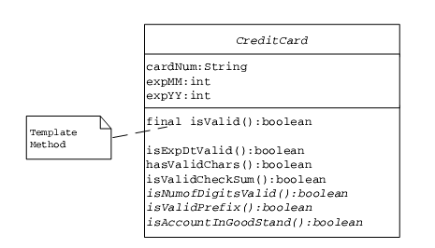
Example - to check the validity of a given credit card

Slide 9
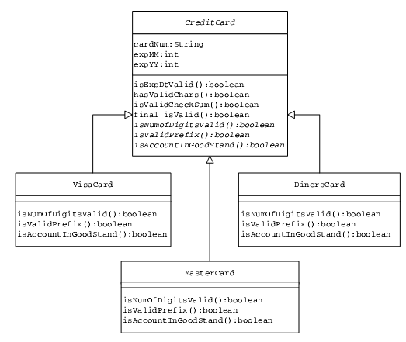
Class Hierarchy

Slide 10
Try…
Identify how the Template Method pattern is used when you design an applet with custom code in any of the applet life-cycle methods (init, start, paint, stop and destroy).

